Slide 1
Linkage between the Syllabus and Learner’s Book

Slide 2
Session Outcomes
  Participants should be able to;
  identify the features and structure of the learner’s book.
  Link the learner’s book to the syllabus

Slide 3
Activity 1
In your group, with reference to the learner’s book and syllabus;
Identify the key features of the learner’s book.
Identify the relationship between the syllabus and learner’s book.
Identify any features in the Learner’s book which are not reflected in the syllabus. What purpose do those features serve?
Share your findings to the plenary

Slide 4
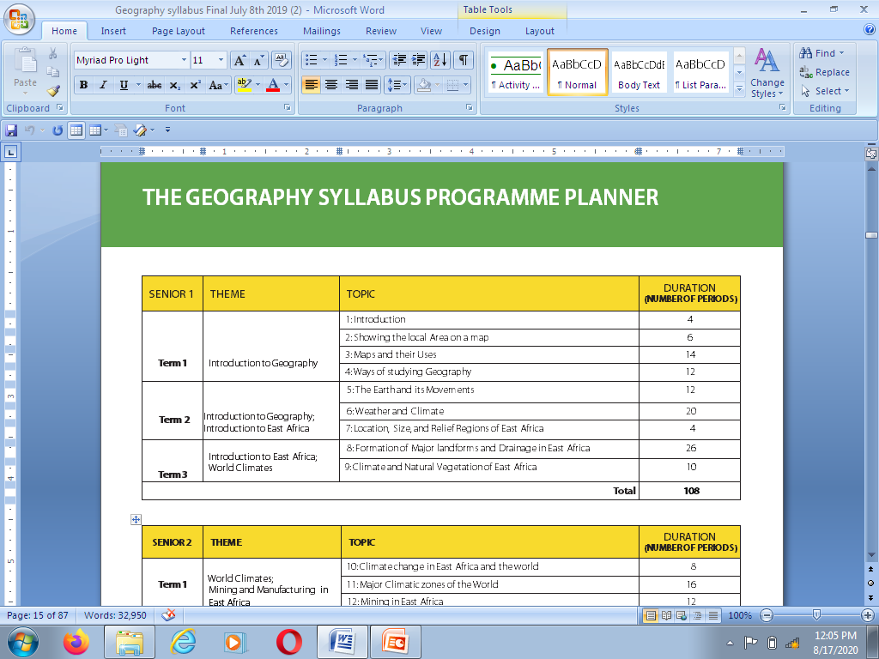

Programme Planner
This becomes a Chapter
Trs Guide
www.ncdc.go.ug

Slide 5
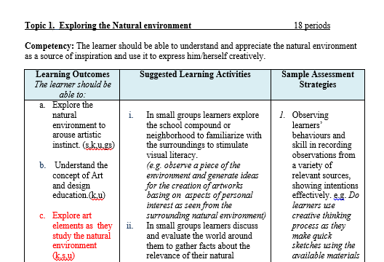
Chapter
Introduction to the chapt 2nd Pg
Reflected in Activities
Tr’s Guide
Tr’s Guide
Appear on Chapter pg
Appears as Sub topic

Slide 6
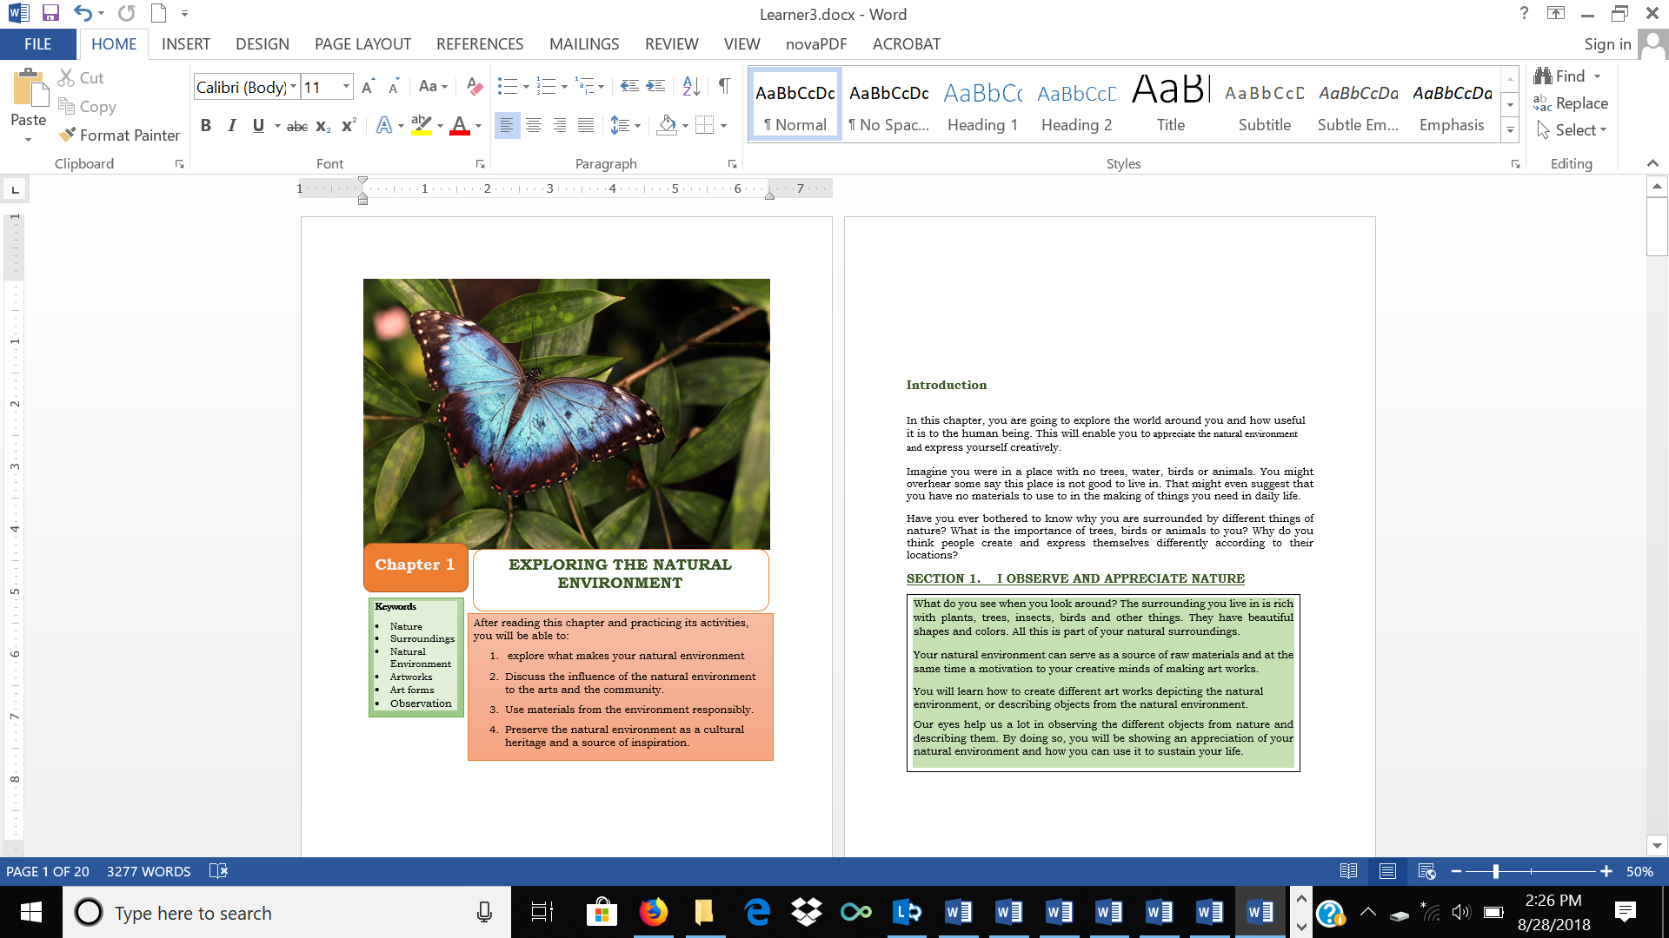
1st Page of a chapter in the Learner’s book and TG
Picture depicting a Chapter
.
Chapter Keywords
Topic in Syllabus
LOs
www.ncdc.go.ug

Slide 7
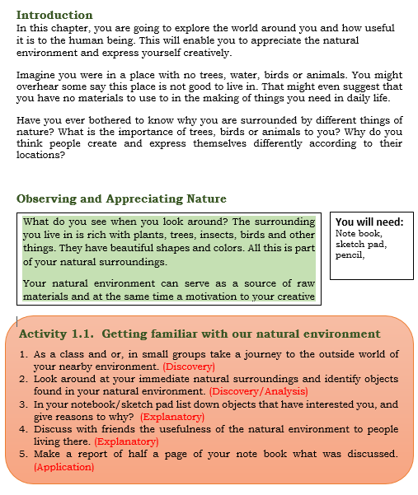
2nd Page of a chapter
Adapted Competency
.
Sub Topic under LO 1
May include a graphic. Say Figure 1.1
Sub Topic Introduction
Activity format
Discovery
Analysis
Explanatory
Application
1st Activity of Chapter 1
www.ncdc.go.ug

Slide 8
Activity of Integration
Last activity to evaluate the learner’s ability to solve a problem through integration of the knowledge, skills and behaviors acquired in the chapter, previous chapters or even other subjects on the curriculum.
It should enable the learner to demonstrate the competency stated in the chapter introduction.
The learner’s response to the activity of integration will show how the learner has mobilized different knowledge, skills, understanding, values.

Slide 9
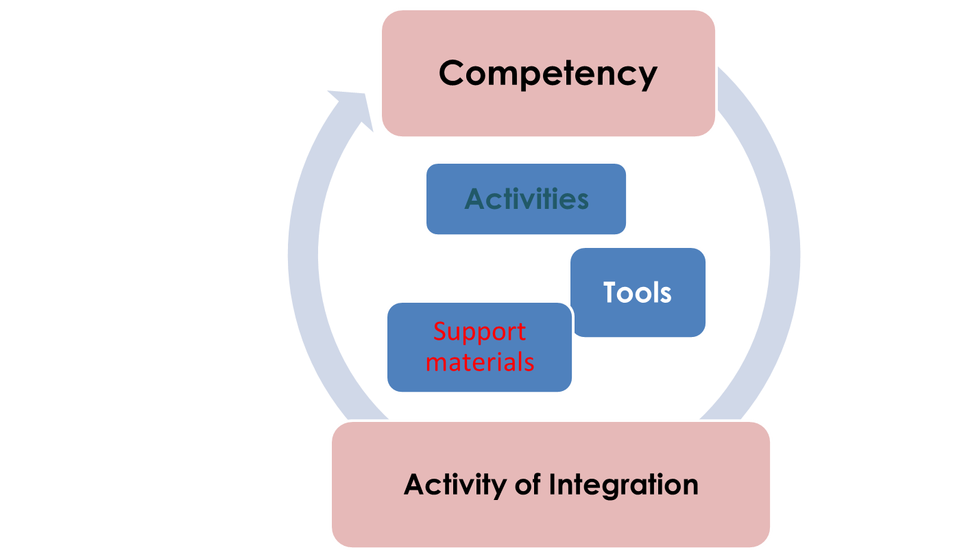
Activity of Integration…
www.ncdc.go.ug

Slide 10
Chapter summary
The chapter summary in the Learner’s book gives a wrap up of what has been covered in relation to the learning outcomes in that chapter.

